Slide 1
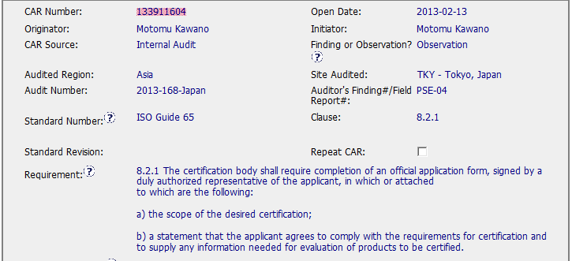
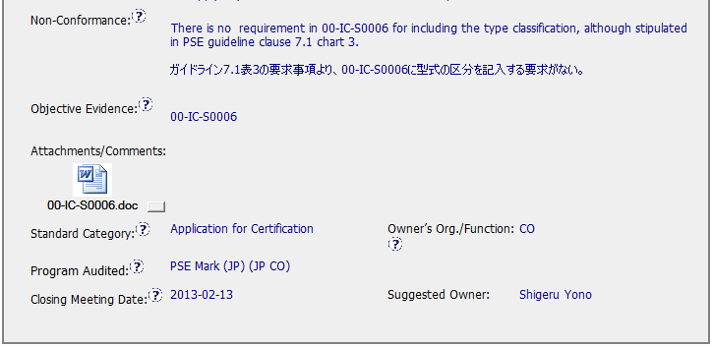
CAR 13911604
OBSERVATION CAR
I didn’t know what PSE guideline was,
but searched for it in DCS and found doc
13-IC-F0400. It is written in Japanese,
so I am unable to read the actual requirement.
Document number and translation would have
been helpful.

Slide 2
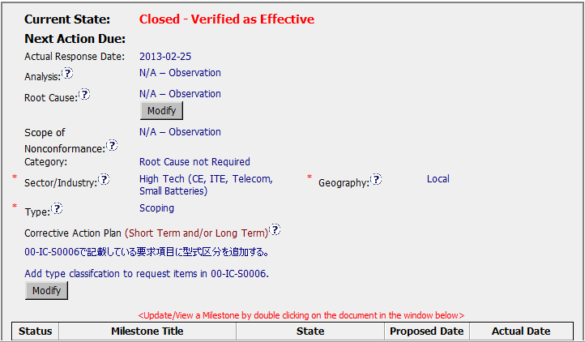
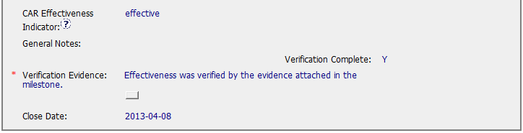
CAR 13911604
CAR effectiveness indicator should be the owner’s suggestion for
how we can verify that the CA was effective.
Closed as effective the same day that the milestone was closed – good job!

Slide 3
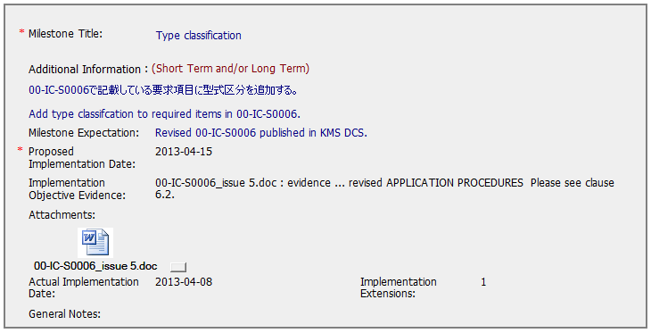
CAR 13911604
Objective evidence is clear – link would be nice.

